Slide 1
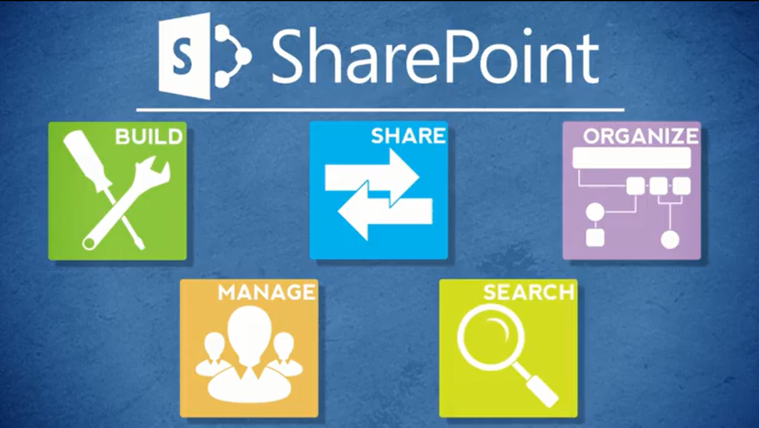
Agenda
Overview
Review
Roles
Lists
Libraries
Columns
Views
Pages
Web Parts
Navigation
Office
Wrap-Up

Slide 2
About SharePoint and Office
SharePoint and Office are tightly integrated
You can create SharePoint lists from Excel spreadsheets

Slide 3
Let’s Learn How to…
Import an Excel spreadsheet into SharePoint
Export an Excel table to SharePoint

Slide 4
Import an Excel Spreadsheet
You must define a range in the spreadsheet before importing
Table range
Named range
Range of cells
Settings gear > Add an app > Import Spreadsheet
Enter a name > Browse > Select spreadsheet > Import
In Excel, select Range Type and Select Range > Import

Slide 5
Export an Excel Table
Spreadsheet must have a table before exporting
Creates a list in Quick Edit mode, so be sure to save
Gotchas
Formulas are converted to values
Conversion does not work for all data types
Open spreadsheet
Click inside table > Table Tools > Design tab > Export > Export Table to SharePoint List
Enter address of SharePoint site > Enter a name > Next > Finish
Select link to SharePoint list
In SharePoint, Stop editing this list to save list

Slide 6
When Do Library Changes Go Live?
Inside
Immediately
Connect team/project sites
Immediately
Unauthenticated (public) area of Connect
Make changes on a staging server; changes are copied to a production server at :42 after the hour
There may be review or approval processes in your area

Slide 7
Exercise 8: SharePoint and Office
Go to the Designer Class home page
Click Exercises for the links you’ll need

